Slide 1
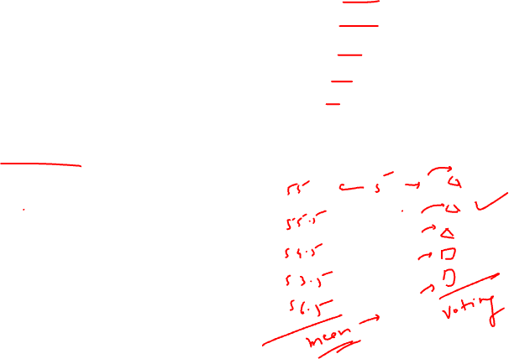
Support Vector Machine ML Model
By Amrita Panjwani

Slide 2
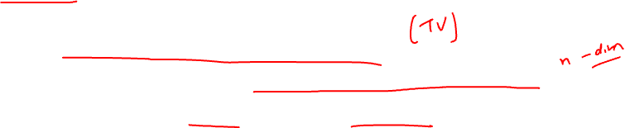
SVM
It is a supervised machine learning model.
It is used when the data relates to high dimension space.
It can be used for classification and regression

Slide 3

Use cases
Classification of genes
Handwriting recognition

Slide 4
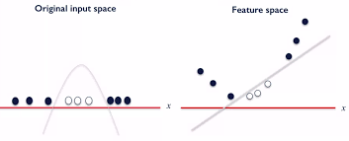
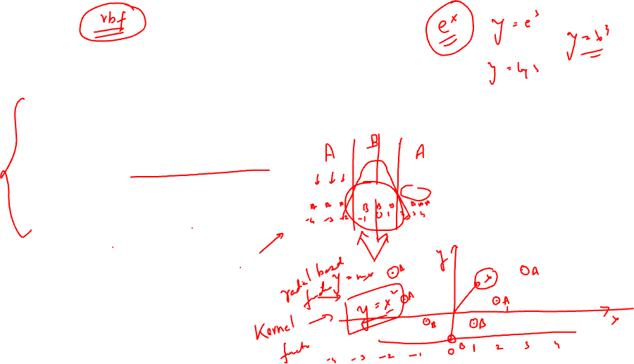
Kernel Function
Sometimes the datapoints are spread out such that it is not possible to segregate them in the existing space. But they are always separable in a higher dimension space. Hence the datapoints are placed in higher dimension space and separate classes for them are created.
The conversion of datapoints to higher dimension space is done with help of a kernel function

Slide 5
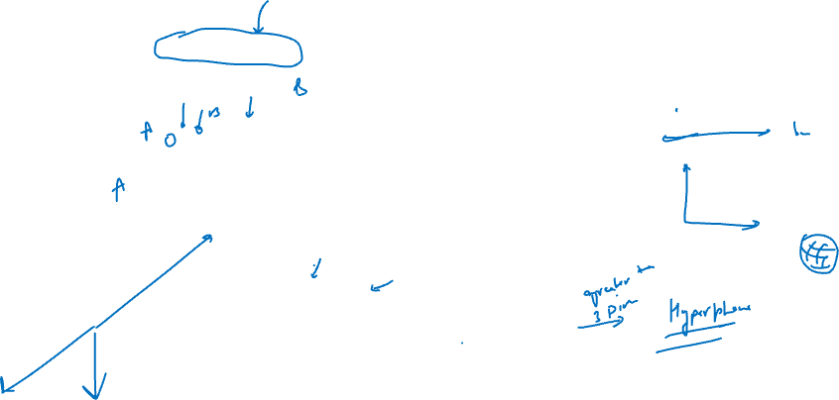
Aim of SVM
To find a hyperplane in a N dimensional space that distinctly classifies the data points.

Slide 6
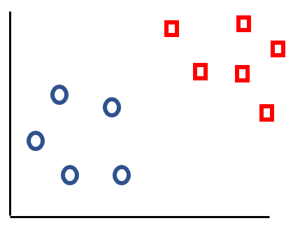
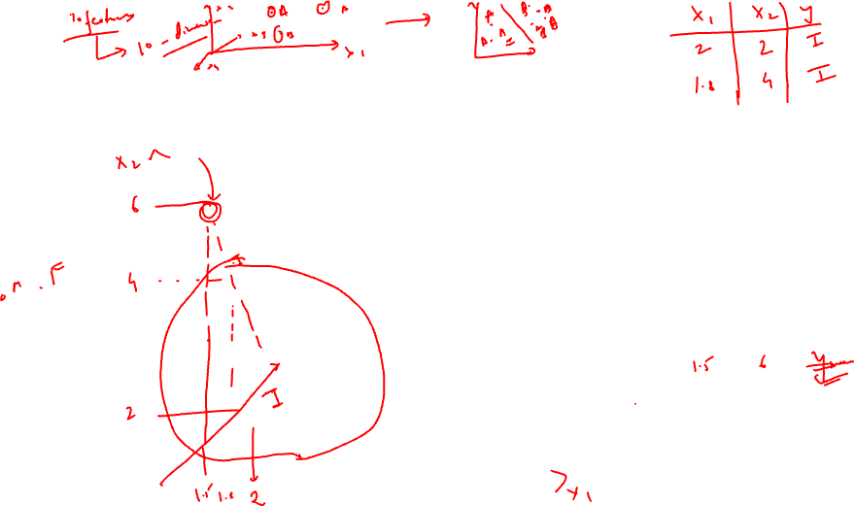
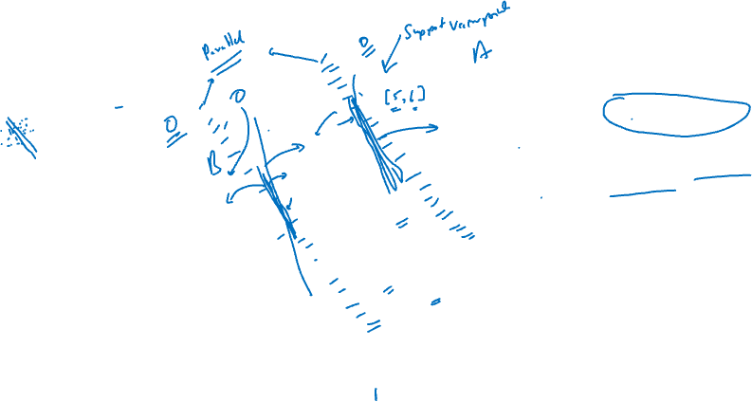
How to select the Hyperplane
The lines tangent to the end points of each class are called support vectors
Draw a line right in between of the two support vectors. This is the required Hyperplane.
SV2
The distance between hyperplane and SV is called ‘Margin’
margin
SV1
Hyperplane
Aim: The hyperplane should be chosen such that it results in maximum margin

Slide 7
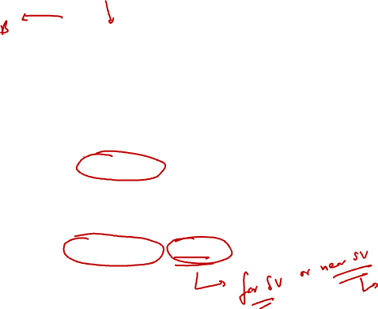

Aim: The hyperplane should be chosen such that it results in maximum margin
In this case there are outliers.
As per the aim , hyperplane with maximum margin must be considered.
So it considers the far set of clusters for its SV
Large Margin
Now how to tell the model which SV to select : near or far ?
For that a hyperparameter : Gamma is defined.

Slide 8
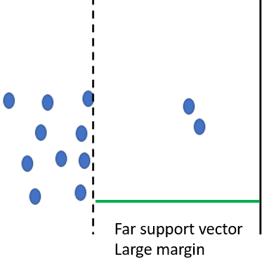
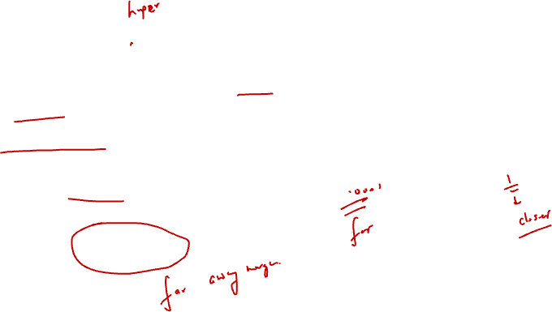
Gamma value
Gamma : This parameter lets the model know which support vector to select: near or far.
Low Gamma , indicates to select the support vector that is far away and it results in large margin.
Hence a low gamma is always preferred.

Slide 9
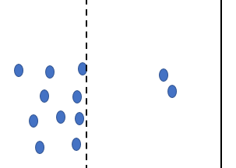
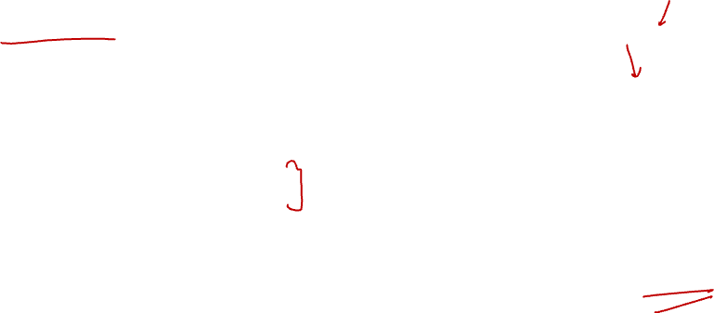
High Gamma , indicates to select the support vector that is near the hyperplane and it results in small margin.
Hence a high gamma is not preferred.
Near support vector
small margin

Slide 10
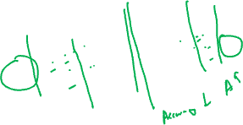
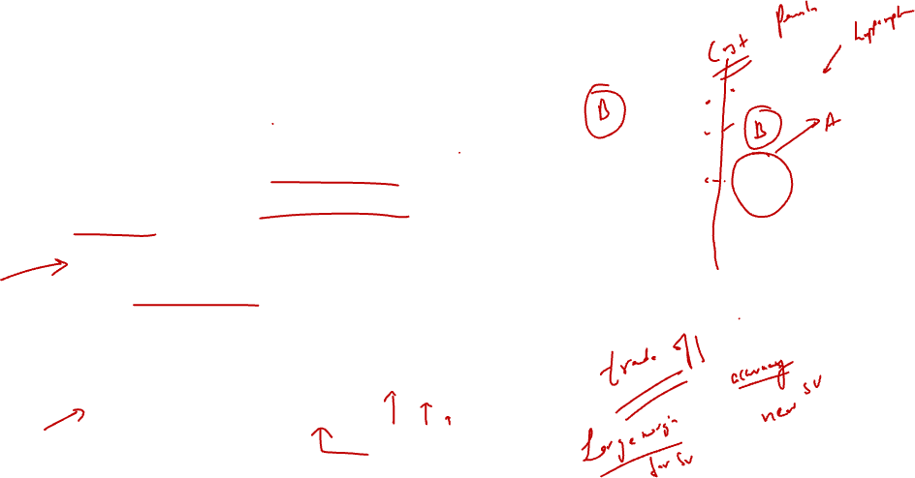
Misclassification
Class I
Misclassified
But it can be observed that when there are outliers a higher margin generated by low gamma value excludes the outliers and hence the outliers are not classified correctly!
This leads to misclassification and reduces the overall accuracy.
Hence to improve the accuracy a new hyperparameter is included in the model: regularization parameter ( c )

Slide 11
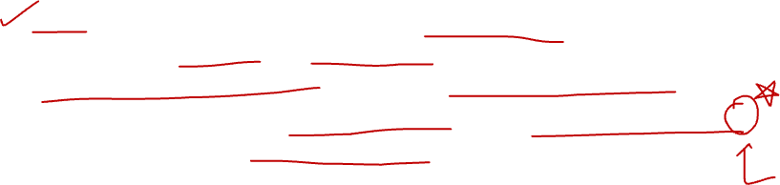
Regularization hyperparameter ( c )
C is the penalty applied for every missclassifcation.
If the value of c is small, penalty is small , this implies the model can tolerate some misclassification and hence the accuracy is low.
But if the model needs strict classification, higher value of C is preferred.
This implies high penalty for misclassification.
So a high value of c leads to high accuracy of the model

Slide 12
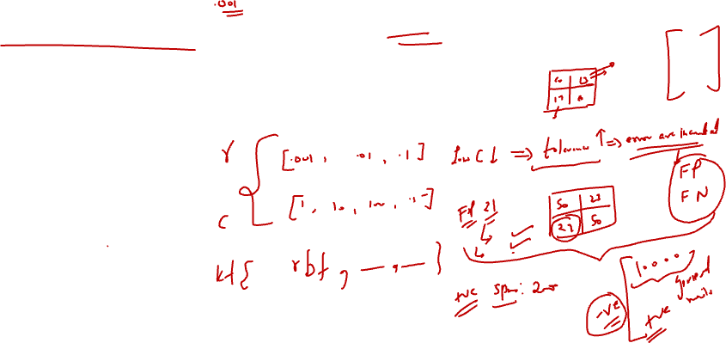
Conclusion:
A low gamma value ( 0.01 or so) and a high c value ( 1 or so) give a perfect balance for the two aims of the SVM model:
High margin and High accuracy

